Slide 1
All Kilton Medals

Slide 2
Early Game

Slide 3
Bombs
Clip out of Shrine of Resurrection
Activate time of day
1 Hylian Shroom, 1 Tree Branch
2 Apples, Axe by Old Man
At boko camp, get
4 Hylian Shroom
6 Spicy Pepper
1 Seared Steak
1 Pot Lid
RUN to Temple of Time, DO NOT surf
Complete rest of split same as Any%
Notes:
Pot Lid must have 5 or more durability at the end of Plateau. Can land on shield for (1) Temple of Time clip, (2) clear skew after Bombs, (3) Magnesis clip, (4) clear skew after Stasis, (5) Cryonis clip.

Slide 4
Plateau
Complete Magnesis and Stasis same as Any%
BLSS to Cryonis, get DLC Chest with 5 Bomb Arrow
Complete rest of Cryonis + Paraglider same as Any%

Slide 5
Kakariko
BLSS to Kakariko
WB to Phrenic Bow, get Blue Nightshade
WB to Fairy Fountain (eat 1 Hylian Shroom if needed)
Get
3 Fairy
2+ Blue Nightshade
3 Endura Carrot
3 Silent Princess
WB to Kakariko (use 1 Fairy)
Get 1+ Apple from offering korok
Turn in 4 Spirit Orbs for 1 stamina upgrade
Save

Slide 6
WMC
Walkthrough Video
IST Sim

Slide 7
WMC1. Break 8 Slots
Clothes shop:
Drop 1 each of Hylian Shroom, Apple, Nightshade, Princess
(Optional) Drop 1 Fairy and use remaining one as check item
Break 4 slots + sell Peppers
Pick everything back up
Break 4 slots again
Pickup 3 items (can be anything)
Buy Hylian Hood
Reload (do NOT save first)

Slide 8
WMC2. Cooking
Get Invalid Star Tab
Roast Endura Carrot
Shoot all Normal Arrow
Equip Phrenic Bow and Bomb Arrow
Eat 1 Seared Steak
Cook 5 Wild Greens, 5 Sauteed Pepper
Break 4 slots
Pick everything back up (edible material in row 2, column 1)
Equip Axe and Pot Lid
Save
Reload

Slide 9
WMC3. Dupe Food
Open/close quick menu
Save
Reload
Open/close quick menu
Save
Reload

Slide 10





WMC4. Prompt Entanglement
Sort Food tab
Eat Normal Arrow (Food 1 Row 3 Col 5)
Eat Hylian Hood (Food 3 Row 2 Col 5)
Cook WMC meal (Food 1 Row 2 Col 5)
3 Roasted Endura Carrot
1 Fairy
1 Spicy Pepper
Save
Reload
Activate Row:
Activate Col 1:
Notes:
Can replace Spicy Pepper with Hylian Shroom or Apple but then the WMC meal won't have a status effect and will require additional menuing later.

Slide 11
WMC5. Transfer CookData
Eat 1 Meal
Save
Reload
Eat 1 Seared Steak*
Save
Reload
Notes:
*Technically, we only need to sync GameData in step 4, but I find clearing out the Seared Steak makes menuing nicer.

Slide 12
WMC6. Corruption
Eat all Food except 2 Sauteed Pepper, 1 Seared Steak, 6 Wild Greens
Drop Traveler's Bow
Drop all Materials except 1 Fairy
Save
Eat 1 Fairy, 2 Sauteed Pepper, 1 Seared Steak
Drop and pickup all other equipment
Unequip all
Reload

Slide 13
WMC7. Omegabow
Save
Eat 1 Seared Steak
Reload
Eat 12 meals in front of Seared Steak
Drop Pot Lid
Save
Unequip Phrenic Bow, Axe
Eat 2 Wild Greens
Reload

Slide 14
WMC8. Stamina + Bow #2
Shoot 1 Arrow
Save
Eat 4 Wild Greens
Unequip Phrenic Bow
Reload

Slide 15
Bow of Light

Slide 16
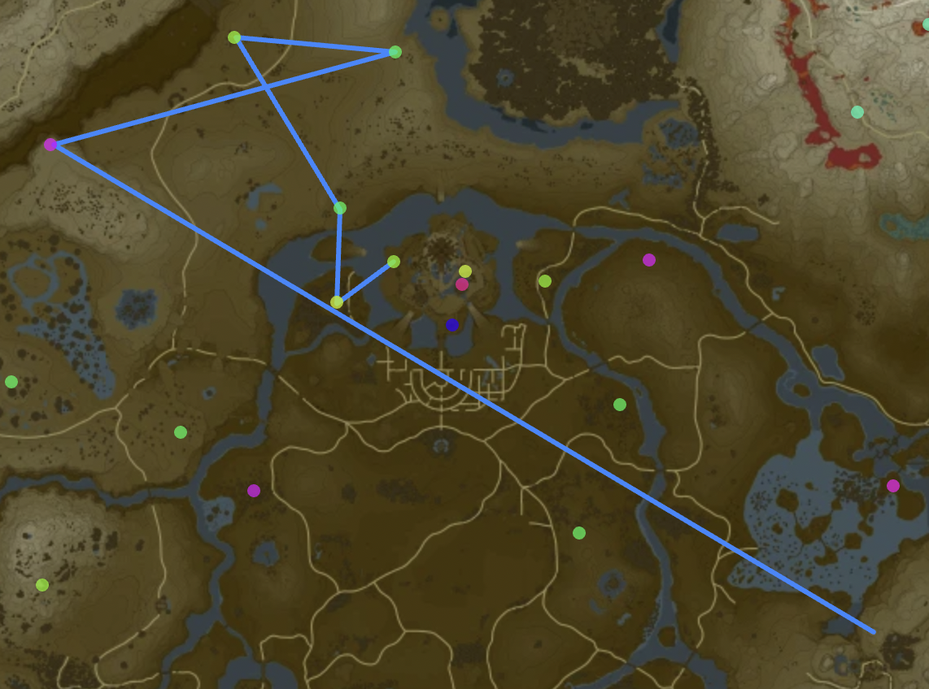
West Castle Branch
BLSS to Upland Lindor Talus
BLSS to Aldor Foothills Hinox
Bomb Arrow a tree for fire and Wood
Drop Wood and all other materials
Make Night
WB to Rowan Plain Stalnox
WB to North Hyrule Castle Hinox
WB to Hyrule Castle West Talus
WB and enter Castle to Hyrule Castle Stalnox
Leave Area

Slide 17
Sanctum
WB to sanctum
Get bullet time skew
Blights
Calamity
Phase 1 - Bomb Arrow
Phase 2 - Skew bounce into bullet time
Dark Beast
Clear skew and ragdoll glitch
Drop shield
Eat all but 7 food
Final shot:
Pause before impact
Switch to Phrenic Bow

Slide 18
WMC9. Bow of Light
Reload game.
Sort bows
Drop shield
Eat all but 8 food
Save
Reload

Slide 19
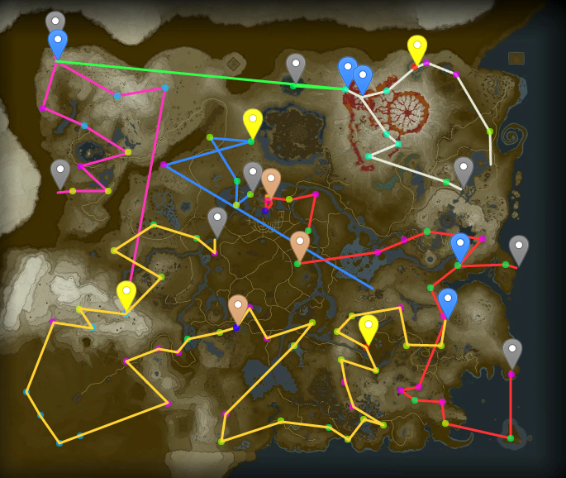
The Rest
object map json (2022-10-30)
video

Slide 20
References

Slide 21

Invalid Star Tab
"Invalid star tab" refers to a state of the inventory where the cursor is hovering over the Star icon. After this state is reached, prompt entanglement becomes possible. The state persists through saving/reloading until we close the game or return to the title screen.
Completing Dark Beast forces a return to the title screen so prompt entanglement is lost at that point in the run.
1/2

Slide 22
Invalid Star Tab
In this run, invalid star tab is activated by
Using IST, transferring the Hylian Hood into the save at Goddess Statue where the armor tab is undiscovered.
Pausing and then tabbing right quickly until the cursor appears over the Star icon.
If #3 doesn't work and instead the cursor appears in the bottom-left, the backup is: unpause+pause twice, then tab left quickly.
2/2

Slide 23
Prompt Entanglement
Pressing A while an item is selected in the inventory brings up a context menu. Different types of items have different context menus.
"Prompt entanglement" refers to a state where the item that the game thinks is selected is not the same as the one that the cursor is currently highlighting. And therefore, an option that is normally only available for materials (such as "Eat") can be applied to something else (such as armor).
1/6

Slide 24
Prompt Entanglement
In this run, prompt entanglement is used to
Eat Normal Arrow slot - All arrow types must be corrupted for WMC. It's faster to corrupt only 1 type of arrow, and bomb arrows are far more valuable.
Eat Hylian Hood - Armor needs to be removed before WMC, and eating is slightly faster than selling.
Hold 3 Roasted Endura Carrots - This is a critical ingredient of the WMC recipe.
2/6

Slide 25
Prompt Entanglement
To entangle the prompts of two items, those items must be in corresponding slots that are 3 pages away from each other (or a multiple of 3 pages).
For example, we can apply the prompt for the item that is in row 2, column 1 of the first Materials page, to Normal Arrows, which is in row 2, column 1, of the Bows page. This is because the order of tabs is:
Bows → Shields → Armor → Materials
3/6

Slide 26
Prompt Entanglement
To execute prompt entanglement, we take two steps to place a glitched cursor on the specific row and column where our target items are.
To place the glitched cursor in the correct row ("activating" that row):
Start 1 page to the right or 2 pages to the left of the target item.
Start in the row below the row of the target item.
Input:
4/6

Slide 27
Prompt Entanglement
The second step "activates" the first column:
Tab left 2 pages
Press
Input:
For ways to activate the 4th row or other columns, see El Duende 05's tutorial.
5/6

Slide 28
Prompt Entanglement
Now the glitched cursor can be moved 3 pages at a time left or right while retaining the prompt of the last slot that was "captured."
To "capture" the prompt of a new slot, move to the system menu (press R) and return to the inventory (press L).
6/6

Slide 29
Weapon Modifier Corruption
When the game adds a food item to inventory, it does it in two steps:
Add the food item to the inventory.
Write the food's CookData (sell price, heart recovery value) to the last loaded item.
If step 1 succeeds, then the "last loaded item" in step 2 is always the added food item. And the game doesn't anticipate that step 1 would ever fail so it does step 2 no matter what.
This means that we can manipulate the game to erroneously write CookData onto another item if we get step 1 to fail.
1/7

Slide 30
Weapon Modifier Corruption
The main discovery of WMC is that when CookData is written onto a weapon, the game interprets it as modifiers for that weapon.
To obtain the correct CookData for the modifiers we want (10-shot, zoom, +attack), we need to include ingredients that normally aren't allowed in recipes. Hence, the relationship between Prompt Entanglement and WMC.
2/7

Slide 31
Weapon Modifier Corruption
One important distinction to keep in mind is that items that are transferred by IST are never "loaded." They persist from the previous save. Only items that are brought into the inventory from a manual save or an autosave are considered loaded in.
This is why an extra save/reload is necessary to corrupt the Bow of Light after Dark Beast.
3/7

Slide 32
Weapon Modifier Corruption
There are two ways that a food item can fail to load into the inventory.
The first is if there are already 3 full pages of food items. This can be triggered by using IST to transfer food to a save that already has food on it. If the number of food transferred + the number of food on the save exceeds 60, then the food items that would be the 61st (and later) will fail to load.
4/7

Slide 33
Weapon Modifier Corruption
In this case, the last loaded item will likely be another food item unless 60 food are transferred (so that no food on the save can load).
If our goal is to write CookData onto a weapon, this method would require at least 62 broken slots to transfer 60 food, impractical for a speedrun.
However, this method is still employed by this setup, to be explained later.
5/7

Slide 34
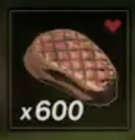
Weapon Modifier Corruption
The second way that a food item could fail to load is specific to stackable food. "Roasted" food -- food that is cooked by fire and not a cook pot -- is stackable: a single slot in the inventory can hold more than one instance of that food.
Similar to materials, a stackable food item will fail to load if the game attempts to add it to an inventory where:
one or more slots containing the same food item already exists in the inventory
the combined total of all stacks would exceed 999
6/7

Slide 35
Weapon Modifier Corruption
The general outline of this setup is:
Force the WMC meal to fail to load and have a Seared Steak (a stackable food) be the last loaded item. The Seared Steak then has the CookData of the WMC meal.
Corrupt the Seared Steak to 500+.
Force the Seared Steak to fail to load and have a Phrenic Bow be the last loaded item.
The Phrenic Bow ends up with the CookData of the Seared Steak which was overwritten by the CookData of the WMC meal.
7/7

